Slide 1

Multi Camera Tracking Project
Spring 2025 –Bi weekly progress - Mar 6

Slide 2
Agenda
Objective
Recap
Current progress
New Dataset Analysis and ReID dataset preparation
Conclusion
Next steps

Slide 3
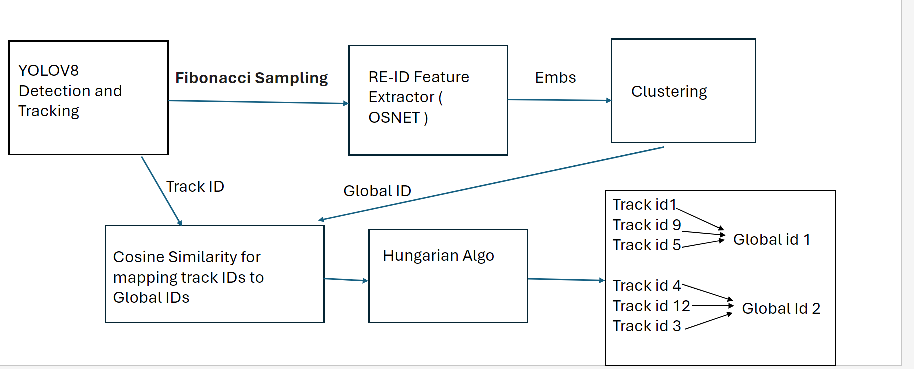
Objective
Project Goal : Developing a robust foundational Mutli camera tracking model , with a focus on person re-identification(Re-ID) tasks for this semester.

Slide 4
Recap
Discussed state-of-the-art person re-identification approaches like CLIP-ReID,CLIP-SCGI and Multi view video generation approach Pippo
Initial experiments with CLIP-ReID , OSNeT on :
Market-1501
Lowe's in-house ReID dataset
Quantitative comparison of CLIP-ReID and OSNeT on both datasets.
CLIP-ReID shows better results than OSNeT in Cross dataset evaluation.
Potential ways to improve CLIP-ReID

Slide 5
Dataset overview : Market-1501 & Lowe's Old ReID Dataset
A Large-scale public benchmark dataset for person re-identification tasks
This dataset consists of 1501 identities.
This dataset consists of 1022 identities.
Split | IDs | Images | Cameras
Train | 751 | 12936 | 6
Query | 750 | 3368 | 6
Gallery | 751 | 15913 | 6
Split | IDs | Images | Cameras
Train | 688 | 13615 | 1
Query | 466 | 3612 | 1
Gallery | 680 | 13625 | 1
Test set
Market-1501 statistics
Lowe's Data statistics
Each identity is present in atleast 2 cameras
Each identity is across only one camera.

Slide 6
Performance Comparison of Market-1501 & Lowe's Data
Market-1501 Dataset
Lowe's Dataset ​
Method | Epochs | mAP | Top-1 Accuracy
OSNeT | 60 | 78.3 | 93.8%
OSNeT | 250 | 85.3% | 93.8%
CLIP-ReID | 60 | 89.8% | 95.3%
CLIP-ReID+SIE+OLP | 60 | 96.6% | 99.9%
Method | Epochs | mAP | Top-1 Accuracy
OSNET | 50 | 95.8% | 98.3%
CLIP-ReID | 60 | 96.6% | 98.3%
CLIP-ReID+SIE+OLP | 60 | 96.6% | 98.2%
No change observed in the metrics. Due to Dataset limitations
13.2% mAP ,
6.5% Top-1 Accuracy
Train set and Test set has Similar Identities​
No Multi camera samples

Slide 7
Cross setting Evaluation
Trained on Market-1501 Train split and evaluated on Lowe's Data(Test Split)
Method | Epochs | Model Param | mAP | Top-1 Accuracy
OSNeT | 50 | 2M | 68.4 | 96.2%
OSNeT | 150 | 2M | 70.2 | 96.7%
CLIP-ReID | 60 | 89M | 80.4 | 96.7%
CLIP-ReID+SIE+OLP | 60 | 89M | 80.7 | 96.7%
17% increase in mAP
CLIP-ReID outperforms OSNet in mAP, suggesting better retrieval performance and better feature discrimination.
OSNeT struggles with domain shift, the learned local features may be dataset specific.
Notes:
HIgher maP means More precise retrival of correct matches across frame in multi-camera tracking.

Slide 8












Data Sample : Lowe's Data , Market-1501
Query:
Train samples :
Query:
Gallery:
Gallery:

Slide 9
Current Progress
Analyzed the New Lowe's Dataset to understand its structure and characteristics.
Developed a ReID dataset preparation workflow for systematic data processing.
Implement a pipeline to convert raw videos into a structured ReID dataset.
Generate dataset statistics, including the number of cameras, images, and scenes.

Slide 10
New Lowe's dataset
Raw videos with 1920x1080p resolution of each 20 min of length
All the videos are annotated in MOT format with 10fps.
There are total of 47 videos across 16 scenes.
Limitation:
Labels are missing for few identities In case of occlusions.
​

Slide 11
ReID Dataset Preparation pipeline
Extract frames from raw videos across all the cameras.
Person centric cropping using the MOT ground truth labels.
Generate Train, Query ,Gallery splits
Format generated dataset in Market-1501 style.

Slide 12
Example video from new Lowe's dataset
I will showcase a video here as an example that visualizes the tracks of multiple people. (Due to large video size I could not transfer from lowe’s system)

Slide 13
Example video from new Lowe's dataset
I will showcase a video with missing trackelets here as an example that visualizes the tracks of multiple people. (Due to large video size I could not transfer from lowe’s system)

Slide 14
Conclusion
Goal : To Enhance person re-identification task of Multi camera tracking framework.
Performed experiments on Market-1501, Lowe's datasets using CLIP-ReID, OSNeT.
Based on the cross setting evaluations, it is evident that CLIP-ReID is better than OSNeT.
Conducted Analysis on Newly collected Lowe's data from store 1573.
Proposed a dataset preparation pipeline to convert the available raw data to person re-id dataset.

Slide 15
Next Steps
​
Creation of ReID Dataset from the Newly Collected videos from Lowe's store 1573.
Perform data cleaning to ensure we have robust person reid data from multiple cameras.
Evaluate CLIP-ReID , OSNeT method on new reid data and observe the improvements.
Utilize Pippo which generates multi-view human turn around synthetic video to enhance ReID task and further tracking.
​

